Slide 1
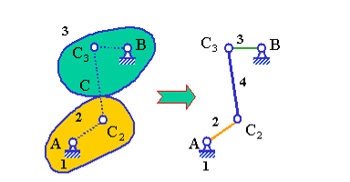
EQUIVALENT LINKAGE
For the purpose of kinematic analysis, a planar higher-pair mechanism can be replaced by an equivalent lower-pair mechanism based on instantaneous velocity equivalence.
Each higher pair is replaced by two lower pairs and a link.
The degrees of freedom of the equivalent mechanism is the same as the original mechanism.
The instantaneous velocity and acceleration relationships between links 2 and 3 of the original and the lower-pair equivalent mechanism are the same.
The equivalence is instantaneous. Because the positions the center of curvature changes as the mechnism moves, different mechanism position will generate a different equivalent linkage.
The higher mechanism (left) and its equivalent linkages (right), in which C2 and C3 are centers of curvature of contact curves on part 2 and part 3 at point C respectively

Slide 2
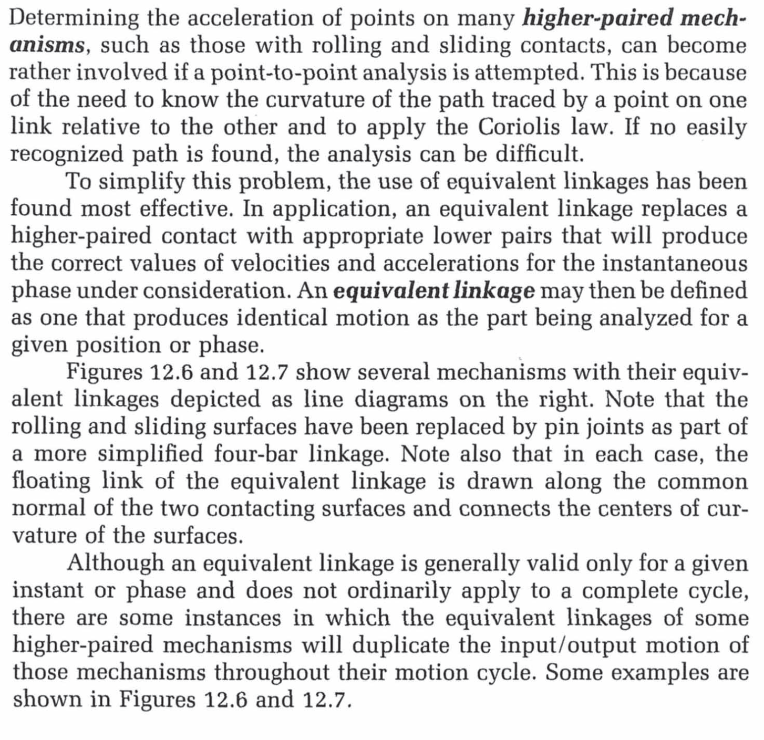

Slide 3
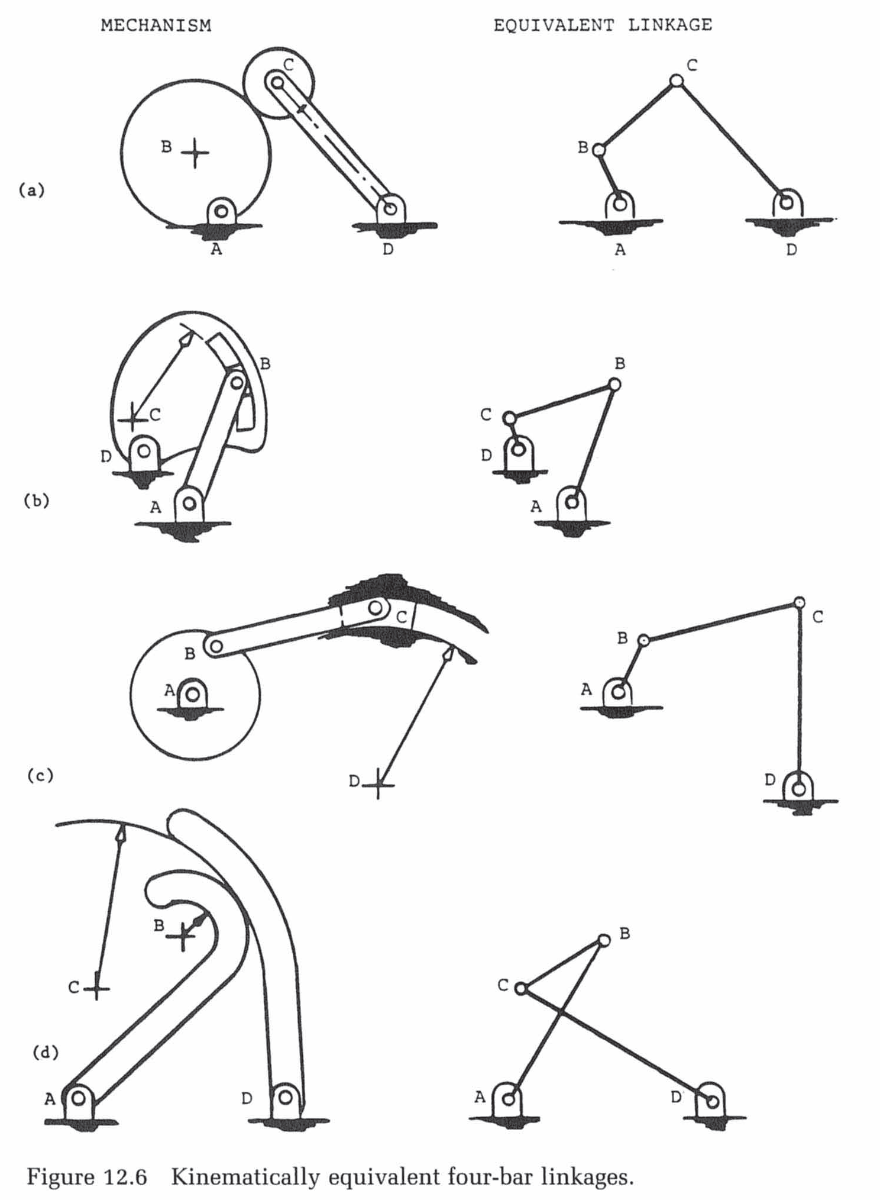

Slide 4
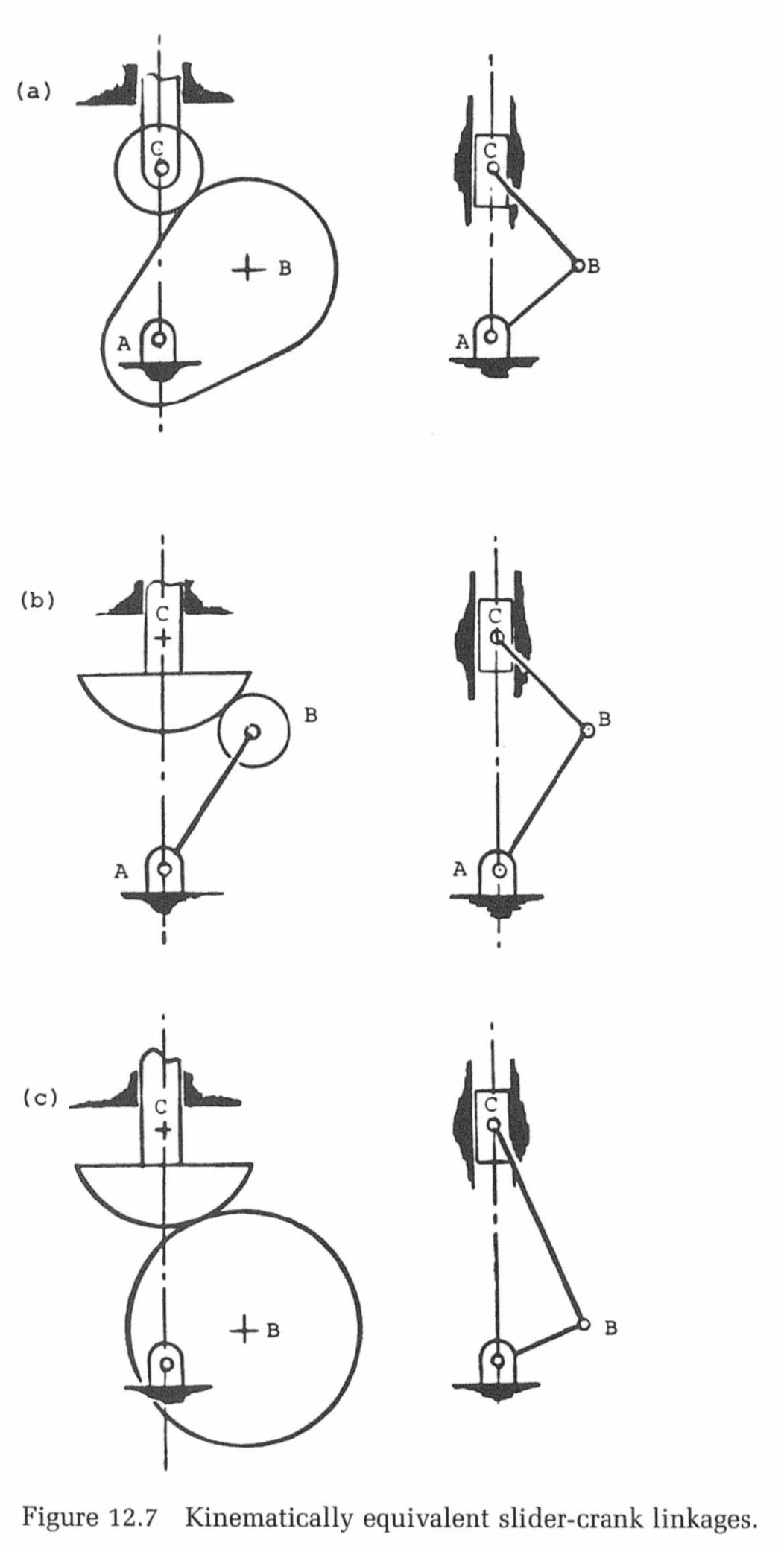

Slide 5
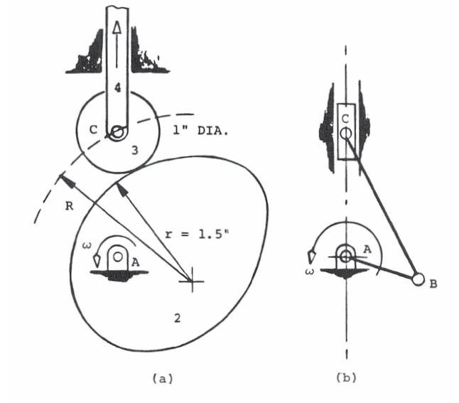
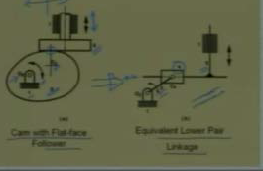

Slide 6
